Slide 1

Knowledge Management
UE17CS342
CASE STUDY
Project Team:
Likith R Shekar PES1201700147
Sakshi Goel PES1201700148
Siddharth Shankar PES1201700691
Dinakar S M PES1201700857
Salman Ahmed PES1201700954
Pooja Patil PES1201701354
Project Guide:
Prof. Krupesha

Slide 2
Rise of IBM
The International Business Machines Corporation (IBM) is an American multinational technology company headquartered in Armonk, New York.
Julius E. Pitrap patented the computing scale in 1885. Alexander Dey invented the dial recorder in 1888. Herman Hollerith patented the Electric Tabulating Machine. Willard Bundy invented a time clock to record a worker's arrival and departure time on a paper tape in 1889. On June 16, 1911, these three companies were combined in New York State by Charles Ranlett Flint forming a company, the Computing Tabulating Recording Company (CTR) based in Endicott, New York.
In 1914, Thomas J. Watson joined the CTR as a General manager and in 11 months became the President of the company.

Slide 3
Rise of IBM
On February 14, 1924 CTR was renamed to International Business Machines ( IBM ).
In 1937, IBM tabulating equipment enables organizations to process huge amounts of data. The US government adopted Social Security Act and made its first effort to maintain the employment records for about 26 million people using IBM punched card machines. The social security related business gave an 81% increase in revenue from 1935 to 1939.
In 1944, IBM co-develops its first computer, the Automated Sequence Controlled Calculator aka Mark l, with Harvard University. It was used by the Navy to calculate gun trajectories.

Slide 4
Rise of IBM
In 1949 Thomas Watson, Sr., created IBM World Trade Corporation, a subsidiary of IBM focused on foreign operations. In 1952 he stepped down after almost 40 years at the company helm, and his son Thomas Watson, Jr. was named president.
In 1956 the company demonstrated the first practical example of artificial intelligence when Arthur L. Samuel of IBM's Poughkeepsie, New York, laboratory programmed an IBM 704 not merely to play checkers but "learn" from its own experience. IBM also developed its first commercial hard disk drive, the 350 RAMAC Disk Storage Unit, which was a major component of the groundbreaking 305 RAMAC computer.
In 1957 the FORTRAN scientific programming language was developed.

Slide 5
Rise of IBM
On April 7, 1964, IBM announced the first computer system family, the IBM System/360. It was followed by the IBM System/370 in 1970.
In 1974 IBM engineer George J. Laurer developed the Universal Product Code. The IBM PC, originally designated IBM 5150, was introduced in 1981, and it soon became an industry standard. In 1991 IBM spun out its printer manufacturing into a new business called Lexmark.
In 2005 the company sold its personal computer business to Chinese technology company Lenovo and, in 2009, it acquired software company SPSS Inc. Later in 2009, IBM's Blue Gene supercomputing program was awarded the National Medal of Technology and Innovation by U.S. President Barack Obama.

Slide 6
Rise of IBM
In 2012 IBM announced it has agreed to buy Kenexa, and a year later it also acquired SoftLayer Technologies, a web hosting service, in a deal worth around $2 billion. In 2014 IBM announced it would sell its x86 server division to Lenovo for $2.1 billion.
In 2015 IBM announced three major acquisitions: Merge Healthcare for $1 billion, data storage vendor Cleversafe, and all digital assets from The Weather Company, including Weather.com and the Weather Channel mobile app. In 2016, IBM acquired video conferencing service Ustream and formed a new cloud video unit. In 2015, IBM bought the digital part of The Weather Company; and in October 2018, IBM announced its intention to acquire Red Hat for $34 billion, which was completed on July 9, 2019.

Slide 7
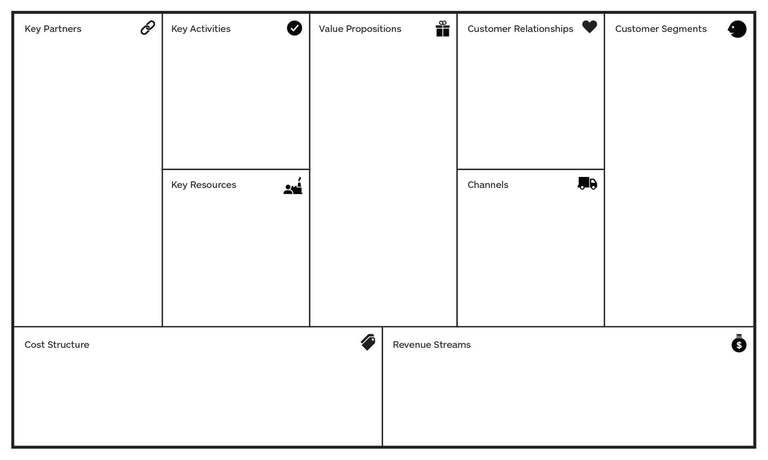
Business Model Canvas

Slide 8

Business Model Canvas
Customer Segment:
Being a company that lives at the intersection of IT and business, it has customer in almost every sector while mainly serving the business market.
Value Proposition:
It provides integrated solutions to businesses and client organizations.
It’s values are its dedication to every client’s success, innovation that matters, and personal responsibility in all relationships.

Slide 9

Business Model Canvas
Channels:
It has channels for customers are Social Media, TV Advertisements, Website and Communities. While, having the One Channel Team for each division.
It used to be Direct Sales Force before which used to only deal with hardware but it changed to Value Added Resellers which handle software and services.
Customer Relationships:
- Personal Service
- Communities
- Co-Creation

Slide 10

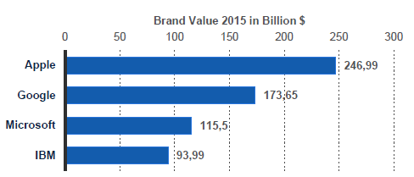
Business Model Canvas
Key Activities:
Core Business - IBM’s core lies in its service, software and hardware. But Software is the only division with major profits.
Supply Chain Management - The supply, manufacturing and logistics operations are integrated in one operating unit that has optimized inventories over time.
R&D - 6% of it’s revenue into R&D, has the most patents (20 a day)
Key Resources:
- Employees
- Brand Value
- Spending Power

Slide 11
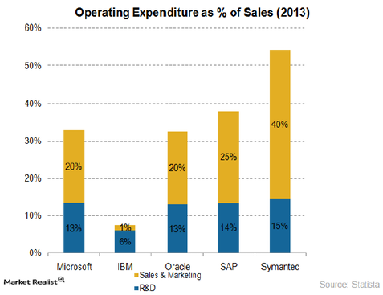
Business Model Canvas
Key Partners:
Maintain existing partners while finding new valuable partners. The purpose is to provide complementary skills and expertise that can result in greater client value.
Revenue Streams:
Services, Software, Hardware, Financing. It focuses mainly into the cloud and data presently.
Cost Structure:
Majority of spending goes into R&D and marketing, the only company with higher R&D expenditure than marketing.

Slide 12
Knowledge Management in IBM
Knowledge management is the practice of using an organization’s content, social networks, experience, and collective intelligence to increase organizational effectiveness and productivity and to spark innovation and transformation.
AT IBM
IBM's KM strategy consisted of turning the company into a leading knowledge management based company, using technology for sharing knowledge and building the required IT infrastructure. The main objective of the KM framework was to facilitate knowledge sharing and collaboration among employees.

Slide 13
Knowledge Management in IBM
KM principles focused on in IBM:
Federated Search: to bring together content from multiple repositories, including external sources and wikis.
Sponsored Links: to surface the most important leadership content.
Expertise Location: to recognize knowledge colleagues on topics across our services and offerings.
Social Networks: to narrow relevant content, identify influences, key practitioners, and hubs of information.

Slide 14
Knowledge Management in IBM
KM principles focused on in IBM:
Sentiment Analysis - to gauge social media insight on key topics.
Personalization - to narrow the field of information to just that which is relevant to the individual.
Rating - to provide peer-ratings and to surface the highest quality content in search results.
Social Tags - to leverage the “wisdom of the crowds” and provide a flexible, dynamic “folksonomy” for easier location and re-use of content.
Contribution “Points” to summarize the impact of individuals’ contributions.

Slide 15
Knowledge Management in IBM
Generating and Sharing Knowledge
The knowledge generated in IBM could be broadly classified as operational data, knowledge assets, intellectual capital, research & analysis, information obtained from the intranet, and the information available from the Internet. The information was obtained from projects carried out in IBM and the details of projects formed on the basis of knowledge sharing.
The Benefits
KM helped IBM in increasing efficiency by the reuse of captured assets and by the transfer of knowledge to improve the skills of employees. It helped the company innovate by bringing in the employees across time and geographic boundaries to share ideas.

Slide 16
Knowledge Enablers and Tools used:
The integration of collaboration and knowledge into portals
and the way people learn is IBM’s main focus for improvement.
Asset Management: The strategy was to provide a knowledge
base of the work and of the colleagues so that assets and
intellectual capital could be reused, enabling client solutions
delivery with better quality and speed.
One asset management tool used was KnowledgeView. It
targeted IBM’s Business Consulting services and contained a
group of repositories that contained key resources and forums
to access reusable assets.

Slide 17
Knowledge Enablers and Tools used:
IBM designed Xtreme Leverage in 1999 as a knowledge
sharing and collaboration tool aimed for software sellers.
The portal maintains intellectual capital, expertise location
and facilities for IBM’s global software brands.
It is the only place for software sellers to go for content and
expertise. It attracts more than 40,000 users with over 400
active communities.

Slide 18
Knowledge Enablers and Tools used:
Expertise Location: The organization BluePage was started by
IBM as a corporatewide directory enabled with instant
messaging and email linkage. It provides searchable resources for
employees looking for experts and networks for collaboration.
On-demand learning: These are workplace portals made to
focus on critical job roles within IBM to deliver the asset
management programs directly to the required audience.
These 2 techniques focus on acquiring knowledge through
collaborations and networking thus strengthening IBM’s
KM resources.

Slide 19
Knowledge Enablers and Tools used:
Supply chain management:
IBM developed many software products to increase SCM
most notably the Sterling SCM which included various products:
Sterling Order Management to coordinate processes.
Sterling Business Network for companies to see relevant
transactions in a single dashboard.
The supply chain network was created to improve key
features for the company to remain connected,
collaborative, Cyber-aware and Comprehensive.

Slide 20
Knowledge Enablers and Tools used:
Joint Ventures:
In order to increase connectivity to acquire knowledge,
IBM has several joint ventures:
Maersk and IBM: JV formed to improve Global Trade and
Digitize Supply chains using Blockchain tools.
IBM and Vodafone: A $550 million USD JV which was
formed to pursue solutions in a variety of developing
technology sectors.
IBM and Toshiba: A JV between the 2 companies,
resulted Toshiba obtaining shares of IBM subsidiary DSC.
New services were provided based on database specialization.

Slide 21
The Decline of IBM
IBM became a follower of technology instead of a leader.
Bad partnering strategies which led competitors to take over the market.
Breaking contracts with customers and employees.

Slide 22
Solutions IBM Should Have Implemented
Focus more on the customer needs.
Poor performers must be removed from the company.
Build healthy customer relationship by meeting customer expectation.
Keeping up to date with new emerging technologies.
Well analysed business expansion strategy with a foolproof plan.

Slide 23
The Comeback of IBM
The new CEO – Lous Gerstner, appointed in April of 1998.
Gerstner identified IBM unique competitive advantage.
The 4 major strategies employed by Gerstner:
Keep the company together.
Change the fundamental economic model.
Re-engineer how was done.
Sell under-productive assets in order to raise cash.

Slide 24
The Comeback of IBM
Eight principles of the “new” IBM:
The marketplace is the driving behind everything we do.
At our core, we are a technology company with an overriding commitment to quality.
Our primary measures of success are customer satisfaction and shareholder value.
We operate as an entrepreneurial organization with a minimum of bureaucracy and a never ending focus on productivity.
We never lose sight of our strategic vision.
We think and act with a sense of urgency.
Outstanding, dedicated people make it all happen, particularly when they work together as a team.
We are sensitive to the needs of all employees and to the community in which we operate.

